Slide 1
Decision Making, Branching
Switch and Break

Slide 2
The switch Statement
Switch is multiple–branching statement where based on a condition, the control is transferred to one of the many possible points.
Enables the program to execute different statements based on an expression that can have more than two values. Also called multiple choice statements.
The expression provided in the switch should result in a constant value otherwise it would not be valid.

Slide 3
The switch statement
The expression is successively compared against the values value1, value2, ..., valuen. If a case is found whose value is equal to the value of expression, the program statements that follow the case are executed.
switch ( expression )
{
case value1:
program statement
program statement
...
break;
case value2:
program statement
program statement
...
break;
case value n:
program statement
program statement
...
break;
default:
program statement
program statement
...
}
The switch test expression must be one with an integer value (including type char) (No float !).
The case values must be integer-type constants or integer constant expressions (You can't use a variable for a case label !)

Slide 4
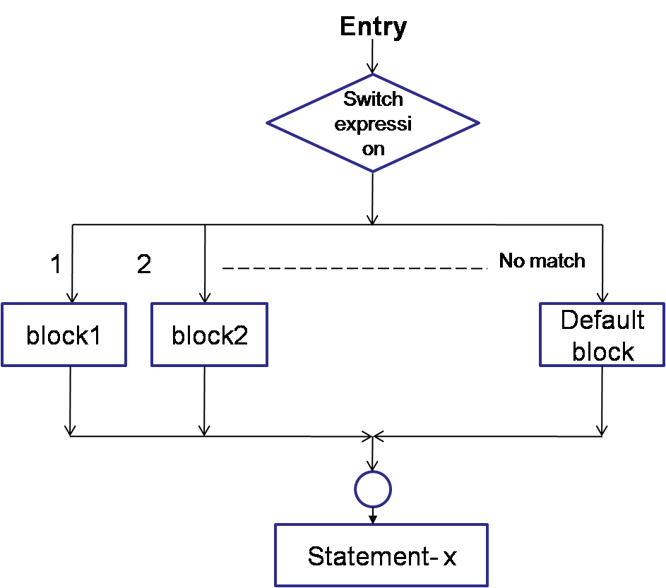
switch- control flow
Notes:
Evaluates the (expression) and compares its integer or character value
with the values following each case label.
1. If a match is found between (expression) and one of the values, execution is transferred to the statement(s) that follows the case label.
2. If no match is found, execution is transferred to the statement(s) following the optional default label.
3. If no match is found and there is no default label, execution passes to the first statement following the switch statement closing brace, the next_statement.
4. To ensure that only the statements associated with the matching template are executed, include a break statement where needed, which terminates the entire switch statement.
5. As usual the statement(s) can also be a block of code put in curly braces.

Slide 5
switch- example 1
#include<stdio.h>
int main()
{
int choice;
printf(“Enter your choice: 1-yes, 2-no\n”);
scanf(“%d”,&choice);
switch(choice)
{
case 1: printf(“YESSSSSSS……”);
break;
case 2: printf(“NOOOOOO……”);
break;
default: printf(“DEFAULT CASE…….”);
} printf(“The choice is %d”,choice);
return 0;
}

Slide 6
switch- example 2
scanf(“%d”,&mark);
switch (mark)
{
case 100:
case 90:
case 80: grade=‘A’;
break;
case 70:
case 60:
grade=‘B’;
break;
case 50:
grade=‘C’
break;
case 40:
grade=‘D’
break;
default: grade=‘F’;
break;
}
printf(“%c”,grade);

Slide 7
An Example – switch case
char ch;
scanf)(“%c”,&ch);
switch(ch)
{
case ‘a’ : printf(“Vowel”); break;
case ‘e’ : printf(“Vowel”); break;
case ‘i’ : printf(“Vowel”); break;
case ‘o’ : printf(“Vowel”); break;
case ‘u’ : printf(“Vowel”); break;
default: printf(“Not a Vowel”); }

Slide 8
An Example – switch case
char ch;
scanf(“%c”,&ch);
switch(ch)
{
case ‘a’:
case ‘e’:
case ‘i’ :
case ‘o’ :
case ‘u’ : printf(“Vowel”); break;
default: printf(“Not a Vowel”); }

Slide 9
Example - switch
/* Program to evaluate simple expressions of the form value operator value */
#include <stdio.h>
int main (void)
{ float value1, value2;
char operator;
float result;
printf("Type in your expression.\n“);
scanf(“%f %c %f”, &value1,&operator,&value2);
switch (operator)
{case '+':
result=value1+value2;
printf(“%f”,result);
break;
case '-': result=value1-value2;
printf(“%f”,result);
break;
case ‘*': result=value1*value2;
printf(“%f”,result);
break;
case ‘/': if ( value2 == 0 )
printf(“Division by zero.\n“);
else result=value1 / value2;
printf(“%f”,result);
break;
default;
printf(“Unknown Operator”);
}
return 0;
}

Slide 10
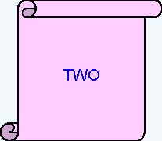
What is the output of the following code snippet?
int iNum = 2;
switch(iNum)
{
case 1:
printf(“ONE”);
break;
case 2:
printf(“TWO”);
break;
case 3:
printf(“THREE”);
break;
default:
printf(“INVALID”);
break;
}

Slide 11
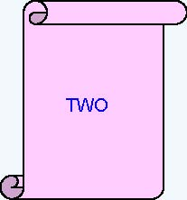
What is the output of the following code snippet?
iNum = 2;
switch(iNum)
{
default:
printf(“INVALID”);
case 1:
printf(“ONE”);
case 2:
printf(“TWO”);
break;
case 3:
printf(“THREE”;)
}

Slide 12
What is the output of the following code snippet?
switch (iDepartmentCode)
{
case 110 : printf(“HRD ”);
case 115 : printf(“IVS ”);
case 125 : printf(“E&R ”);
case 135 : printf(“CCD ”);
}
Assume iDepartmentCode is 115
find the output ?
IVS E&R CCD

Slide 13
What is the output of the following code snippet?
int iNum = 2;
switch(iNum)
{
case 1.5:
printf(“ONE AND HALF”);
break;
case 2:
printf(“TWO”);
case ‘A’ :
printf(“A character”);
}

Slide 14
Check Validity:
switch(1+2+23)
switch(1*2+3%4)
switch(a*b+c*d)
switch(a+b+c)
Important Points:
Duplicate case values are not allowed
Nesting of switch statements is allowed

Slide 15
int main()
{
int x = 1;
switch (x)
{
x = x + 1;
case 1: printf("Choice is 1");
break;
case 2: printf("Choice is 2");
break;
default: printf("Choice other than 1 and 2");
break;
}
return 0;
}
Output:: Choice is 1

Slide 16
int main()
{
int x = 1;
switch (x)
{
case 2: printf("Choice is 1");
break;
case 1+1: printf("Choice is 2");
break;
}
return 0;
}
Output::
Compiler Error: duplicate case value

